Slide 1
DevOps Will Save The World! Public Safety, Public Policy, and DevOps in Context
Joshua Corman, Sonatype CTO
Oct 23, 2014 DevOps Enterprise Summit #DOES14

Slide 2

~ Marc Marc Andreessen 2011

Slide 3
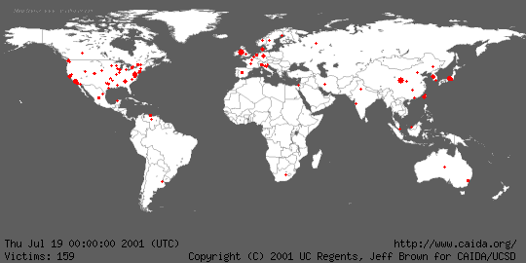
Notes:
http://www.caida.org/research/security/code-red/coderedv2_analysis.xml#animations

Slide 4

Trade Offs
Costs & Benefits

Slide 5
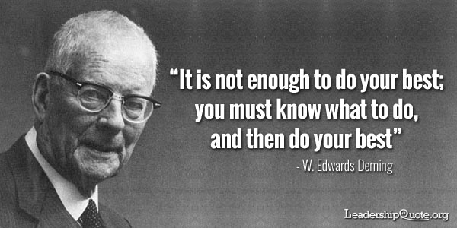

Slide 6
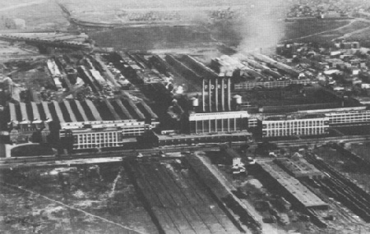
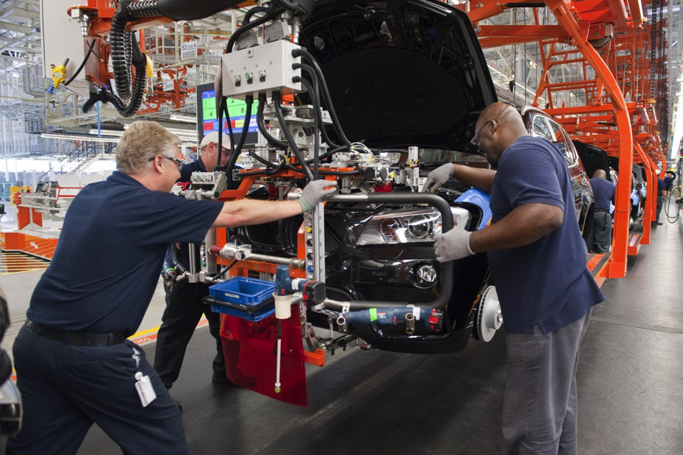
Industrial Evolution
Notes:
The gist of this slide is to inform the audience that this isn’t really a new problem. It’s just new to our industry. We can take consolation in the fact that we aren’t alone and that we can learn from those that have come before us. For example tracking auto parts to consumers for recall purposes.

Slide 7
The real implications of heartbleed

Slide 8

Beyond Heartbleed: OpenSSL in 2014 (17 in NIST’s NVD thru July 25)
As of today, internet scans by MassScan reveal 300,000 of original 600,000 remain unpatched or unpatchable
CVE-2014-3470 6/5/2014 CVSS Severity: 4.3 MEDIUM ← SEIMENS *
CVE-2014-0224 6/5/2014 CVSS Severity: 6.8 MEDIUM ← SEIMENS *
CVE-2014-0221 6/5/2014 CVSS Severity: 4.3 MEDIUM
CVE-2014-0195 6/5/2014 CVSS Severity: 6.8 MEDIUM
CVE-2014-0198 5/6/2014 CVSS Severity: 4.3 MEDIUM ← SEIMENS *
CVE-2013-7373 4/29/2014 CVSS Severity: 7.5 HIGH
CVE-2014-2734 4/24/2014 CVSS Severity: 5.8 MEDIUM ** DISPUTED **
CVE-2014-0139 4/15/2014 CVSS Severity: 5.8 MEDIUM
CVE-2010-5298 4/14/2014 CVSS Severity: 4.0 MEDIUM
CVE-2014-0160 4/7/2014 CVSS Severity: 5.0 MEDIUM ← HeartBleed
CVE-2014-0076 3/25/2014 CVSS Severity: 4.3 MEDIUM
CVE-2014-0016 3/24/2014 CVSS Severity: 4.3 MEDIUM
CVE-2014-0017 3/14/2014 CVSS Severity: 1.9 LOW
CVE-2014-2234 3/5/2014 CVSS Severity: 6.4 MEDIUM
CVE-2013-7295 1/17/2014 CVSS Severity: 4.0 MEDIUM
CVE-2013-4353 1/8/2014 CVSS Severity: 4.3 MEDIUM
CVE-2013-6450 1/1/2014 CVSS Severity: 5.8 MEDIUM
Notes:
NIST’s NVD (National Vulnerability Database_ http://web.nvd.nist.gov/view/vuln/search-results?query=OpenSSL&search_type=all&cves=on
← SEIMENS was affected by 4 OpenSSL flaws beyond HeartBleed. One from 2010
http://www.scmagazine.com/siemens-industrial-products-impacted-by-four-openssl-vulnerabilities/article/361997/
“Several Siemens products used for process and network control and monitoring in critical infrastructure sectors are affected by four vulnerabilities in the company's OpenSSL cryptographic software library.
The vulnerabilities – CVE-2014-0224, CVE-2014-0198, CVE-2010-5298, and CVE-2014-3470 – can be exploited remotely, and fairly easily, to hijack a session as part of a man-in-the-middle attack or to crash the web server of the product, according to a Thursday ICS-CERT post.
Siemens has already issued updates for APE versions prior to version 2.0.2 and WinCC OA (PVSS), but has only issued temporary mitigations for CP1543-1, ROX 1, ROX 2, and S7-1500.
The products are typically used in the chemical, critical manufacturing, energy, food and agriculture, and water and wastewater systems sectors, according to the post.”

Slide 9
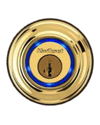
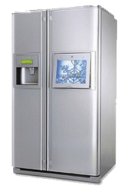
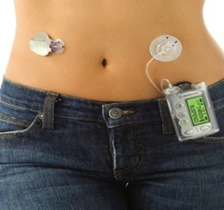
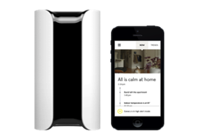

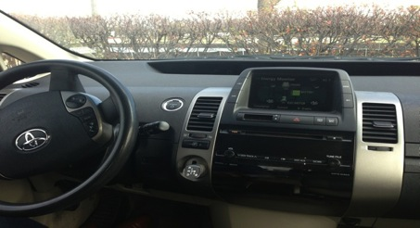


Heartbleed + (UnPatchable) Internet of Things == ___ ?
In Our Bodies
In Our Homes
In Our Cars
In Our Infrastructure
Notes:
See also @iamthecavalry grass roots effort to drive public safety in these four areas of technology dependence.
www.iamthecavalry.org

Slide 10
Notes:
www.ruggedsoftware.org
https://www.ruggedsoftware.org/documents/

Slide 11
Notes:
www.ruggedsoftware.org
https://www.ruggedsoftware.org/documents/
“I recognize that my code will be attacked by talented and persistent adversaries who threaten our physical, economic, and national security“

Slide 12




I Am The Cavalry
The
The Cavalry isn’t coming… It falls to us
Problem Statement
Our society is adopting connected technology faster than we are able to secure it.
Mission Statement
To ensure connected technologies with the potential to impact public safety and human life are worthy of our trust.
Why Trust, public safety, human life
How Education, outreach, research
Who Infosec research community
Who Global, grass roots initiative
What Long-term vision for cyber safety
Medical
Automotive
Connected
Home
Public
Infrastructure
Collecting existing research, researchers, and resources
Connecting researchers with each other, industry, media, policy, and legal
Collaborating across a broad range of backgrounds, interests, and skillsets
Catalyzing positive action sooner than it would have happened on its own

Slide 13
5-Star Framework
Addressing Automotive Cyber Systems
5-Star Capabilities
Safety by Design – Anticipate failure and plan mitigation
Third-Party Collaboration – Engage willing allies
Evidence Capture – Observe and learn from failure
Security Updates – Respond quickly to issues discovered
Segmentation & Isolation – Prevent cascading failure
Connections and Ongoing Collaborations
Security
Researchers
Automotive
Engineers
Policy
Makers
Insurance
Analysts
Accident
Investigators
Standards
Organizations
https://www.iamthecavalry.org/auto/5star/

Slide 14

Sign and share the petition
http://bit.ly/5starauto

Slide 15
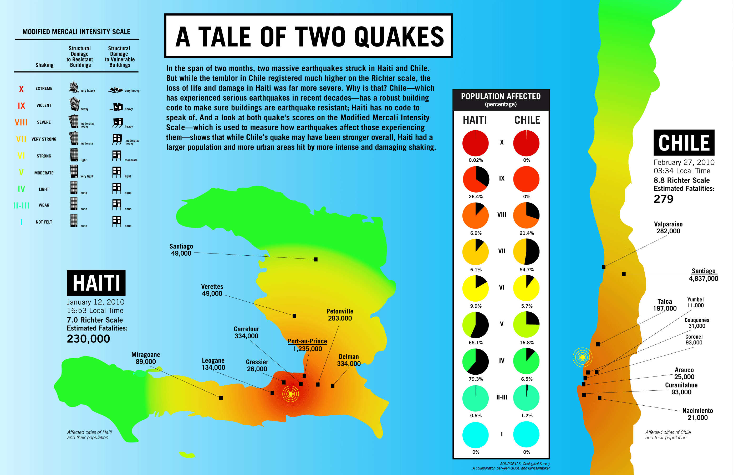

Slide 16
SW Supply Chain in context of Cybersecurity Big Picture
Notes:
We see many signs adversaries have notices the ease and leverage of attacking widely depended upon OpenSource porjects (like Struts, Spring, Guice, OpenSSL [Heartbleed])

Slide 17
Key questions
Where are Attackers most focused?
Where are Defenders most focused?
Which Activities have the most security impact?

Slide 18
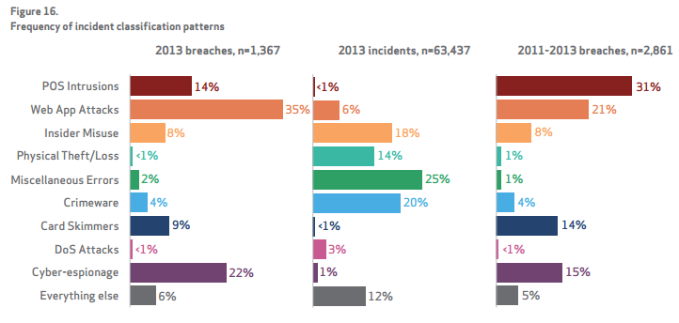
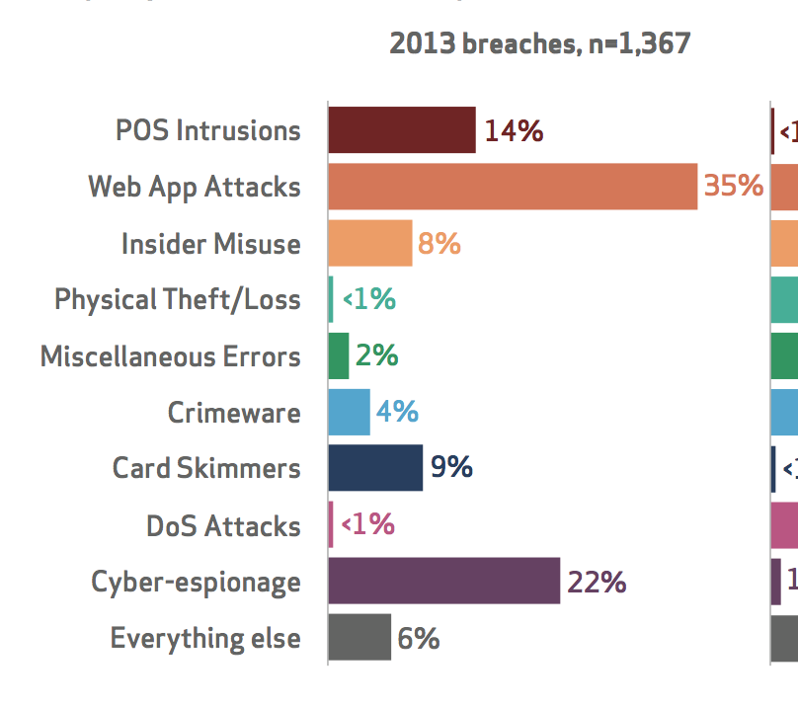
MOST Attacked: Weak Software is #1 Attack Vector
-2014 Verizon Data Breach Investigations Report
Notes:
Verizon Data Breach – Figure 16
Web app is the top attack surface – NOTE: This is BEST CASE, since JUST Web Apps – other categories also count as Application/Software Weaknesses
This column of figure 16 is the % of attacks leading to breached records (other tables/columns show attack patterns not directly tied to breached records)

Slide 19
Least Spending/Priority: Weak Software
Software Security gets LEAST $ but MOST attacker focus
spending
People Security ~$4B
Software
Security ~$0.5B
Data Security ~$5B
Host Security ~$10B
Network Security ~$20B
Source: Normalized spending numbers from IDC, Gartner, The 451 Group ; since groupings vary
Notes:
Not finished, but attempts to show…
LEAST Spend:
Application Security gets 1/80th of the spending of security dollars (about $0.5B of about $40B)
MOST Attacked:
Contrast this with applications are the most attacked vector at this point in the threat landscape.
E.g.The 2013 numbers from Verizon Business Data show Web Application attacks by far were the #1 vector leading to data disclosure
And within AppSec, nearly all focus is on the 10% of code that’s written in modern applications – not the assembled 3rd party and OpenSource Components – like the devastating Struts vulnerability in 2013.

Slide 20




Least Spending/Priority: Weak SW
Software Security gets LEAST $ but MOST attacker focus
Worse, within Software, existing dollars go to the 10% written
spending
attack risk
People Security ~$4B
Written Code Scanning
Software Security ~$0.5B
Data Security ~$5B
Host Security ~$10B
Assembled 3rd Party & OpenSource Components
~90% of most applications
Almost No Spending
Network Security ~$20B
Source: Normalized spending numbers from IDC, Gartner, The 451 Group ; since groupings vary
Notes:
Not finished, but attempts to show…
LEAST Spend:
Application Security gets 1/80th of the spending of security dollars (about $0.5B of about $40B)
MOST Attacked:
Contrast this with applications are the most attacked vector at this point in the threat landscape.
E.g.The 2013 numbers from Verizon Business Data show Web Application attacks by far were the #1 vector leading to data disclosure
And within AppSec, nearly all focus is on the 10% of code that’s written in modern applications – not the assembled 3rd party and OpenSource Components – like the devastating Struts vulnerability in 2013.

Slide 21



Most Impact: Buy/Build Defensible Software
Counter-measures
Situational Awareness
The software & hardware we build, buy, and deploy. 90% of software is assembled from 3rd party & Open Source
Operational Excellence
Defensible Infrastructure
10%
Written
Notes:
“Defensible Infrastructure” (relatively Stronger/Weaker software and infrastrcuture) is THE MOST IMPORTANT factor for the security of any environment…
i.e. would you want to fight the zombie hordes in a broken down wooden barn or in a brick school building
But/and increasingly… 90% of that is OpenSource code of unknown [origin, quality, security]

Slide 22
Is it open season on open source?
Notes:
We see many signs adversaries have notices the ease and leverage of attacking widely depended upon OpenSource porjects (like Struts, Spring, Guice, OpenSSL [Heartbleed])

Slide 23

Think like an Attacker
Now that software is assembled…
Our shared value becomes our shared attack surface
Notes:
From an attacker eye view… it used to require finding a flaw in Bank XYZ and then exploiting that bankand only than bank… but now….

Slide 24










Think like an Attacker
One risky component, now affects thousands of victims
one easy target
Notes:
…if an attacker finds a flaw in Struts… it can attack EVERY bank who uses it – which is most of them.
Same reason Heartblled was so far reaching… shared depenedance == shared risk/attack surface
POINT: INCREASE in attacker interest/value – aka Blood is in the water…

Slide 25




Open Source usage is exploding
Component Usage Has Exploded
Growth Drivers
Mobile
Cloud
Web Apps
Big Data
13 Billion
Requests in 2013
Notes:
POINT: Increase in Dependence – including .gov and financial service where they had resisted prior to 2008/2009
Increase in attacker focus + increase in dependence == ______
2007: 500M
2008: 1B
2009: 2B
2010: 4B
2011: 6B
2012: 8B
2013:13B

Slide 26
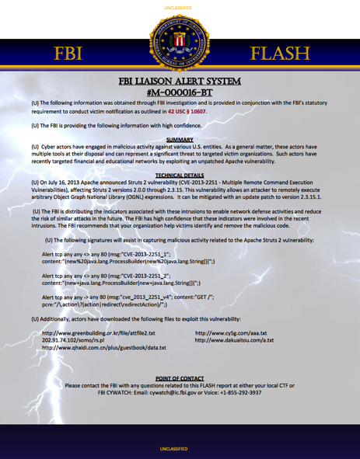
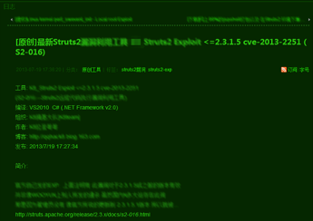
Struts
Global Bank
Software
Provider
Software
Provider’s Customer
State University
Three-Letter
Agency
Large Financial
Exchange
Hundreds of Other Sites
Notes:
Before the highly publicized OpenSSL Heartbleed
Last summer/fall… a worst case CVSS 10 flaw in the hugely popular Apache Struts Project was used to compromise most of the banks and other serious targets above.
This bug had been there for YEARS unnoticed.
Many had to be told by the FBI that they were compromised
This triggered the FS-ISAC to issue guidance on 3rd Party and OpenSource Supply Chain risk… out of necessity
The 3 letter agency SHOCKED me… but alas is true
The green is a Chinese attack tool out almost immediately after the CVE was announced.

Slide 27
w/many eyeballs, all bugs are SHALLOW? Struts
Latent 7-11 yrs
CVSS
10.0
CVE-2013-4316
CVE-2012-0838
CVE-2013-2251
CVE-2013-2135
9.0
CVE-2012-0392
CVE-2013-2134
CVE-2012-0391
CVE-2013-1966
CVE-2013-2115
CVE-2013-1965
8.0
CVE-2006-1547
7.0
CVE-2006-1546
CVE-2012-0394
CVE-2012-4386
CVE-2012-0393
6.0
CVE-2013-4310
CVE-2013-2248
5.0
CVE-2010-1870
CVE-2011-5057
CVE-2008-6505
CVE-2011-2088
CVE-2012-4387
CVE-2014-0094
CVE-2006-1548
CVE-2008-6504
CVE-2013-6348
4.0
CVE-2005-3745
CVE-2008-2025
CVE-2011-2087
CVE-2012-1006
CVE-2007-6726
CVE-2012-1007
CVE-2008-6682
3.0
2.0
CVE-2011-1772
1.0
2005
2006
2007
2008
2009
2010
2011
2012
2013
2014
Notes:
I looked deeper into the Apache Struts Project.
A pattern I’ve recognized is that there is more vulnerability/attacker interest in the most depended upon OpenSource Projects.
Struts is one of the most depended upon – especially so in the Financial Services industries…
As previously stated, one of the CVSS lvl 10 (of 10) struts vulnerabilities wreaked havoc on
POINT: There are more vulnerabilities – and more serious ones…. in the recent year to two.
I may ask this gets dynamically autogenerated per-project by my teams.
NOTE: Many of these flaws were dormant a VERY long time – despite the “many eyeballs” false belief.
NOTE: I personally think this more speaks to attacker/aversary interest.

Slide 28
Bouncy Castle
In 2013, 4,000 organizations downloaded a version of Bouncy Castle with a level 10 vulnerability 20,000 times …
Into XXX,XXX Applications…
Seven years
after the vulnerability was fixed
National Cyber Awareness System
Original Notification Date: 03/30/2009
CVE-2007-6721 Bouncy Castle Java Cryptography API
CVSS v2 Base Score: 10.0 HIGH
Impact Subscore: 10.0
Exploitability Subscore: 10.0
Notes:
Here are just a few examples so you can see that this risk is real…
Bouncy Castle is a popular open source component… and even after critical security alerts were issued in 2009, 4000 companies still downloaded it 20,000 times.
And that was five years after a better, safer replacement was issued.
This is a level 10 critical security risk. Imagine the exposed applications out there… maybe some of them store your personal credit card data or other personal information.

Slide 29
HTTPClient 3.x
In December 2013, 6,916 different organizations downloaded a version of httpclient with broken ssl validation (cve-2012-5783) 66,824 Times …
More than one year after the alert
National Cyber Awareness System
Original Release Date: 11/04/2012
CVE-2012-5783 Apache Commons HttpClient 3.x
CVSS v2 Base Score: 5.8 MEDIUM
Impact Subscore: 4.9
Exploitability Subscore: 8.6
Notes:
This example is even worse… a version of httpclient with a broken SSL validation downloaded by 6,916 organizations 66,824 times more than a year after the alert.
It wasn’t hard for us to find these examples… this just skims the surface.
Some of you may have heard about the FBI Warning last year about Struts… a vulnerable – and old – version of this framework was used to hack into a handful of large organizations.It mde a lot of news. But people are still using it today.

Slide 30
Is it time for a software supply chain?

Slide 31
Elegant Procurement Trio
1) Ingredients:
Anything sold to $PROCURING_ENTITY must provide a Bill of Materials of 3rd Party and Open Source Components (along with their Versions)
2) Hygiene & Avoidable Risk:
…and cannot use known vulnerable components for which a less vulnerable component is available (without a written and compelling justification accepted by $PROCURING_ENTITY)
3) Remediation:
…and must be patchable/updateable – as new vulnerabilities will inevitably be revealed

Slide 32
Procurement Trio + Bouncy Castle
In 2013, 4,000 organizations downloaded a version of Bouncy Castle with a level 10 vulnerability 20,000 times …
Into XXX,XXX Applications…
Seven years
after the vulnerability was fixed
National Cyber Awareness System
Original Notification Date: 03/30/2009
CVE-2007-6721 Bouncy Castle Java Cryptography API
CVSS v2 Base Score: 10.0 HIGH
Impact Subscore: 10.0
Exploitability Subscore: 10.0
Notes:
Here are just a few examples so you can see that this risk is real…
Bouncy Castle is a popular open source component… and even after critical security alerts were issued in 2009, 4000 companies still downloaded it 20,000 times.
And that was five years after a better, safer replacement was issued.
This is a level 10 critical security risk. Imagine the exposed applications out there… maybe some of them store your personal credit card data or other personal information.

Slide 33
Supply Chain Management
OPTIMIZATION
(Monitoring)
SUPPLIER
SUPPLY
SELECTION
INTEGRATION
DELIVERY
PROJECTS
COMPONENTS
COMPONENT
VERSION
PLATFORMS & TOOLS
APPLICATION
Notes:
This isn’t new – it’s new to us…it’s a maturity of the industry
and components are new to the s/w industry
Not sure the supplier is something worth shaking down…there aren’t big guys but more little guys…more like the kickstarter movement.
Supplier means nothing b/c the Supplier is equivalent
Can get data on how people use it but can’t necessarily get info on the people who make up the project or getting them to self-certify…
Project level info we can get from the users
Apache, Eclipse or JBOSS can work but over time that is becoming less important in the overall component landscape.
Key is “what is everyone doing” – what are the behaviors that are good indicators of the quality of work that is produced in any project.
# of people in project and # of commits is “braindead” what OHLO does…more elegant way is possible (MH)

Slide 34
Industrial Evolution
Notes:
The gist of this slide is to inform the audience that this isn’t really a new problem. It’s just new to our industry. We can take consolation in the fact that we aren’t alone and that we can learn from those that have come before us. For example tracking auto parts to consumers for recall purposes.

Slide 36
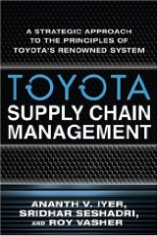
Toyota’s Transformation of the Automobile Industry: v4L
Comparing the XXXX and Prius
$39,900 versus $24,200
1,788 units versus 23,294
Plant suppliers: 125 versus 800
Firm-wide suppliers: 224 versus 5,500
In-house production: 27% versus 54%
Notes:
Comparing Toyota and General Motors

Slide 37
Toyota’s Transformation of the Automobile Industry: v4L
Variety of products offered
Velocity of product flow
Variability of outcomes against forecast
Visibility of processes to enable learning

Slide 38
Toyota’s Transformation of the Automobile Industry: v4L
Variety of software produced
Velocity of software delivery
Variability of outcomes against forecast
Visibility of processes to enable learning

Slide 39
The ‘L’ in v4L
Create Awareness (transparency)
“Unless problems are seen, they will not be solved. Systems need to be in place to report ideas, problems, deviations, and potential issues with no delay.”
Establish capability (empower)
“Unless someone is capable of solving a problem that might arise within the boundaries set for him or her, that person will be unable to contribute to the problem solving process.”
Make action protocols (govern)
“Actions have to be taken within a set of constraints, and they must conform to certain standards.”
Generate system-level awareness (monitor)
“As experience with solving problems is obtained, greater awareness of other areas that might be affected needs to be created.”

Slide 40
Core Principles
Create Awareness
Empower
Govern
Monitor

Slide 41
“Part”
Compound Project
Consumer
Discovery
Repair
Aware
Recovery
Repair
Discovery
Airbag
Airbag
Airbag
Airbag
Airbag
Car X
Alex’s Jaguar

Slide 42
“Part”
Compound Project
Consumer
Discovery
Repair
Aware
Recovery
Repair
Discovery
Airbag
Airbag
Airbag
Airbag
Airbag
Car X
Alex’s Jaguar
Airbag
Airbag
Struts
Airbag
Airbag
Bank of X…
Sally Bank Customer
Airbag
Airbag
Struts
Airbag
Airbag
IBM WebSphere
Bank of X…
Airbag
Airbag
Bouncy Castle
Airbag
Airbag
20,000 Applications
x ??? Users

Slide 43
True Costs & Least Cost Avoiders: Downstream
Enterprise
$
Enterprise
$
$
Enterprise
$
$
$
$
$
$
$
Bank
Bank
$
$
$
Bank
$
$
$
$
$
$
$
Retail
Retail
$
$
$
Retail
$
$
$
$
$
$
$
ACME
Manufacturing
Manufacturing
$
$
$
Manufacturing
$
$
$
$
$
$
$
BioPharma
$
BioPharma
$
$
BioPharma
$
$
$
$
$$$
$
$
$
Education
$
Education
$
$
Education
$
$
$
$
$
$
$
High Tech
High Tech
$
$
$
High Tech
$
$
$
$
$
$
$

Slide 44
Part (Bolt)
Compound Parts
Product
End Consumer
Discovery
Repair
Aware
Recovery
Repair
Discovery
Aware
Recovery
Foo_0
Foo_0
Foo_0
Foo_1
Foo_1
Foo_1
Foo_2
Foo_2
Foo_2
Foo_3
Foo_3
Foo_3
Foo_4
Struts 2
IBM WebSphere
Foo_4
Foo_4
Foo_5
Foo_5
Foo_5
Bank of X.com
Foo_6
Foo_6
Foo_6
Foo_7
Foo_7
Foo_7
Foo_8
Foo_8
Foo_8
Foo_9
Foo_9
Foo_9
Foo_ 10
Foo_ 10
Foo_ 10
Foo_11
Foo_11
Foo_11
Notes:
41% 1st level dependencies get fixed – EVER
Of those, they take 390 days MTTR
Filtering just for CVSS 10s – the MTTR is 224 days.
Since this can be n tiered – it is actually a lot worse.

Slide 45
Commercial Responses to OpenSSL
X Axis: Time (Days) following initial HeartBleed disclosure and patch availability
Y Axis: Number of products included in the vendor vulnerability disclosure
Z Axis (circle size): Exposure as measured by the CVE CVSS score
Notes:
Qualitative takeaways:
Virtually all major (and not so major) software vendors are building on a stack of open source (including security vendors).
The breadth of use across some vendors, IBM most notably is remarkably high (open source is not just in a few rogue products).
New discoveries are getting more serious over time.
New discoveries are getting less vendor attention (fewer vendor disclosures) despite their being more serious.
Vendors are responding to new discoveries at a somewhat slower pace.
The significant increase in product disclosures after the later OpenSSL disclosures, which affect all versions of OpenSSL not just versions 1.0.1 or later, implies that many vendors and products were using old libraries (version 0.9.8 was first released in July, 2005).
Total disclosures: 227
Total product instances affected by disclosures: 2,513
Mean time to repair: 35.8
Median time to repair: 22.0

Slide 46
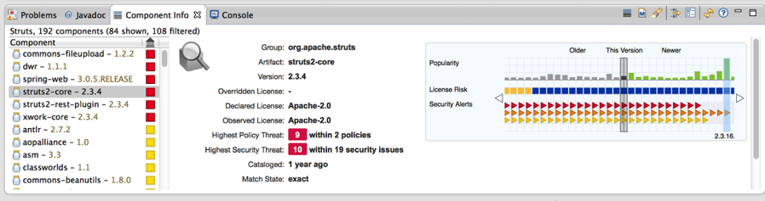
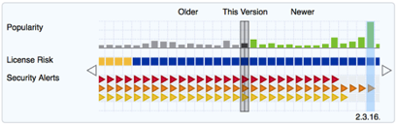
How can we choose the best components from the start?
Analyze all components from within your IDE
License, Security and Architecture data for each component, evaluated against your policy
Shift Upstream = ZTTR (Zero Time to Remediation)
@451wendy
@joshcorman
Notes:
Click onto pane and zoom in and zoom out
Guide your eyes to the RIGHT….
This is a normal Developer IDE called Eclipse…
Sonatype made a PLUGIN within it to show a developer the component BEFORE before they choose or commit to ELECTIVE/AVOIDABLE Risk/AttackSurface/Complexity/LegalIssues …
The RED chain (e.g.) is every version of Strut2-core…. And if you move RIGHT far enough…. It will lack KNOW CRITICAL vulnerabilities.
The Green bar charts are the download popularity… which doesn’t speak at all to SECURITY… but may give people more comfort that it is stable and being used.
License rsik is based on self-defined policy – we track if the use of this license can cause your whole website to now be FREE common opensource – like GPL… which might be very bad for you… and a DIFFERENT type of risk…

Slide 47
Manual Policies Can’t Work at DevOps Speed or Enterprise Scale

Slide 48





If you’re not using secure components
you’re not building secure applications
Component Selection
Component Selection
Development
Build and Deploy
Production
Notes:
You have at risk components flowing into your organization. It is an absolute fact.
And we’re not just talking about security issues… you also have some quality issues and software licensing issues that make it illegal to use a component for a commercial use.
It’s like building a car with parts manufactured by unknown vendors… and no criteria to be met.

Slide 49
Today’s approaches
Aren’t working
90% of repositories have 1+ critical vulnerability
!
46m vulnerable components downloaded
!
71% of apps have 1+ critical or severe vulnerability
!
Component Selection
Component Selection
Development
Build and Deploy
Production
Notes:
Despite some efforts to manage component usage, it just isnt working…
We know this because we know how many vulnerable components are downloaded…
We know how many, on average, end up in your Nexus repository manager
And we know how many, on average, end up in your applications
When Sonatype looks at our downloads from our curated “Central Repository” The free Parts Warehouse on the internet (there were 46M downloads of vulnerable binaries)
In our free/pay for Nexus local On Premise cached copies at development companies… 90% still contain one or more of the MOST SEVER vulnerabilities – so not well cleansed
When our free and paid Application Health Checks look at APPLICATIONS built from these local repositories… 71% of those applications STILL have Worst case vulnerabilities.
The Industry is not cleansing the supply chain (yet) – primary reason, they don’t know/look at/evaluate the quality of the “supply in the supply chain” – too manually/hard to look at NIST NVD (e.g.)

Slide 50
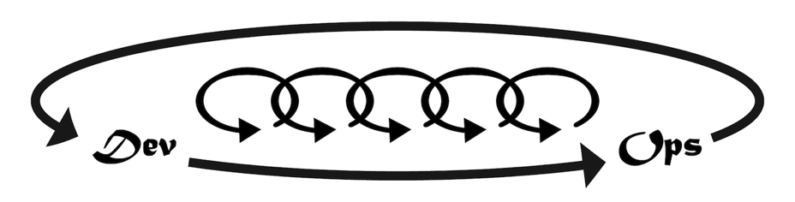
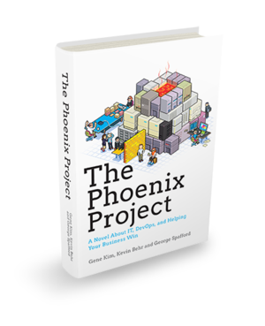
Rugged Devops and Gene’s “Three Ways”
Systems Thinking
Amplify Feedback Loops
Culture of Continuous Experimentation & Learning

Slide 51
Adopt a "DevSecOps" Mindset
Policies, Models, Templates
Predict
Issues
Requirements
Build Assemble
Prevent Issues
Monitoring and Analytics
Detect Issues
Test
Deploy
Remediate/ Change
IT Operations Intelligence and Security Intelligence
Source: Neil MacDonald Gartner
Notes:
A longer term implication of AWS is one of speed and agility for the provisioning and deprovisioning of IT services, including security. Security policy enforcement devices such as firewalls have traditionally been set manually via a console. Within AWS and other cloud services, this mindset will switch to setting policies programmatically using APIs to configure security policy enforcement points based on policy. This will be achieved typically using scripts or automation tools such as Chef, Puppet and others where the security policies are embedded and configured within scripts/blueprints/recipes that drive the configuration without requiring human intervention.
This "need for speed" and shift in organizational thinking is captured within a movement referred to as "DevOps" — cultural/mindset change that tears down the traditional walls within IT (development on the left side of this slide, operations and security on the right side) to deliver faster IT-enabled capabilities for the business. Whether you call this "DevOps" or simply the need for spped and IT agility, the result is the same. IT needs to be able to provision/deprovision workloads more quickly and to do this, people, tools and processes must change. Security needs to be an integral part of this transformation — thus the term "DevSecOps," bringing security into the center of this shift.

Slide 52


Counter-measures
Situational Awareness
DevOps
Operational Excellence
DevOps
Defensible Infrastructure
DevOps

Slide 53
Further Resources
Notes:
We see many signs adversaries have notices the ease and leverage of attacking widely depended upon OpenSource porjects (like Struts, Spring, Guice, OpenSSL [Heartbleed])

Slide 54
As Open Source Usage Expands, So Do the Risks
Security Budgets Are Out of Sync with Risk and Reality
Pareto Principle 2.0? (the “90/10” Rule): Low Effort and Big Gains
You Use a Software Supply Chain. How Well Do You Manage It?
Empower Your Developers. They’re Your Front Line Defense
Manual Policies Just Don’t Work in a Secure Development Lifecycle
Agile Development Requires Agile Security

Slide 55
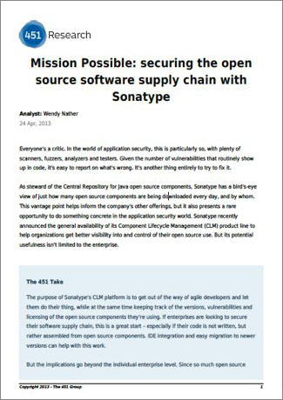
“Sonatype presents a rare opportunity to do something concrete in the application security space. One of the 1st tools that comes close to remediation not just scan results and recommendations.”
-- Wendy Nather
Notes:
Sonatype presents a rare opportunity to do something concrete in the application security space.
One of the 1st tools that comes close to remediation not just scan results and recommendation

Slide 56
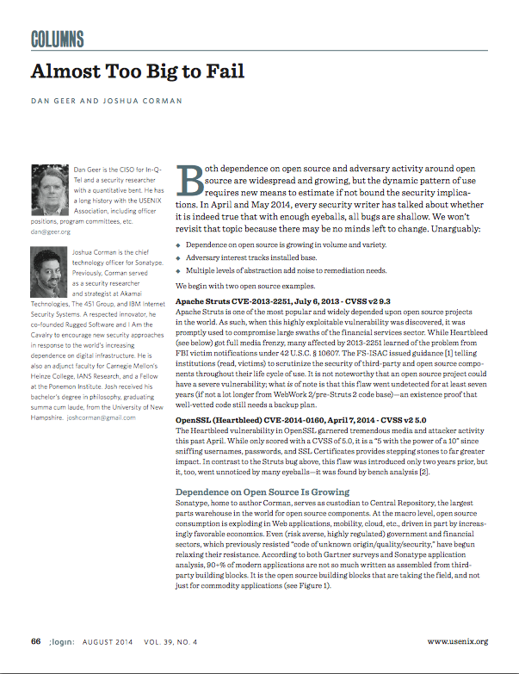
For the 41%
390 days (median 265 days). CVSS 10s 224 days.
https://www.usenix.org/system/files/login/articles/15_geer_0.pdf
Notes:
Sonatype presents a rare opportunity to do something concrete in the application security space.
One of the 1st tools that comes close to remediation not just scan results and recommendation

Slide 57
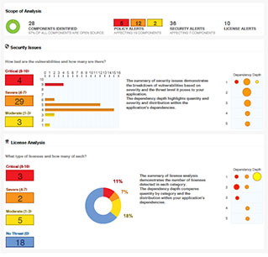
Sample open source visibility report:
Summary: The number of components analyzed, including security issues and licenses used
Bill of Materials: A complete list of the components used in your application
Security Analysis: Known security threats by vulnerability and severity level
Quality Analysis: Details component age, fingerprint verification & adherence to policies
License Analysis: License descriptors for every component & license implication for your application
Notes:
English

Slide 58
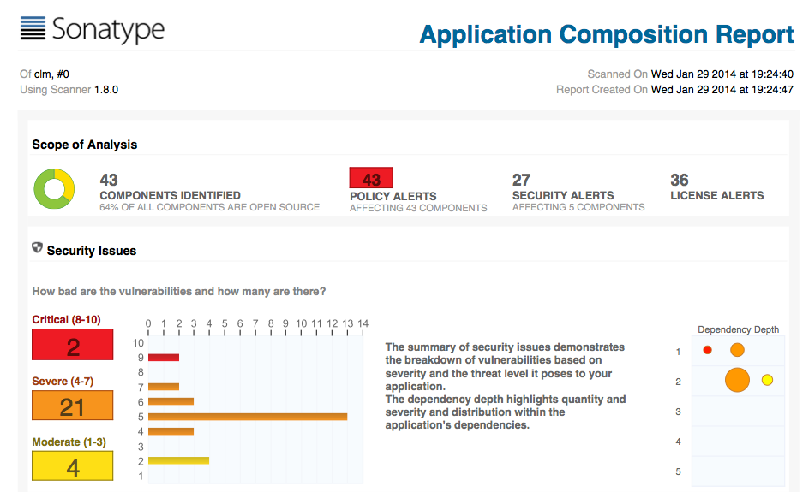
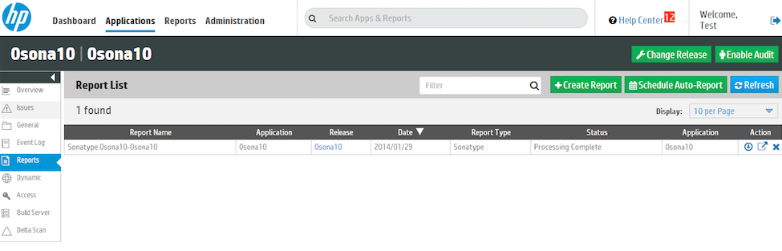
Notes:
English
English
· Install and run CLM Server
· Setup organization, a test app, and a policy
· Added configuration options for FoD to point to CLM instance, user/pass, and id of the test application
· Created task in FoD task service to generate Sonatype report
· Created FoD beta flag for Sonatype, which allows per tenant enable/disable
· Added logic to the static payload uploader to trigger Sonatype report generation after upload completes
· This triggers task service to run the CLM scanner on the payload
· After the scanner completes its work, task service reads the resulting scan id
· Task service makes REST call to CLM to get resulting PDF using scan id to identify
· Task service creates report entry pointing to the newly downloaded PDF

Slide 59
A final Thought…
Notes:
We see many signs adversaries have notices the ease and leverage of attacking widely depended upon OpenSource porjects (like Struts, Spring, Guice, OpenSSL [Heartbleed])

Slide 60


Slide 61
THANK YOU
@joshcorman
@sonatype

